Slide 1

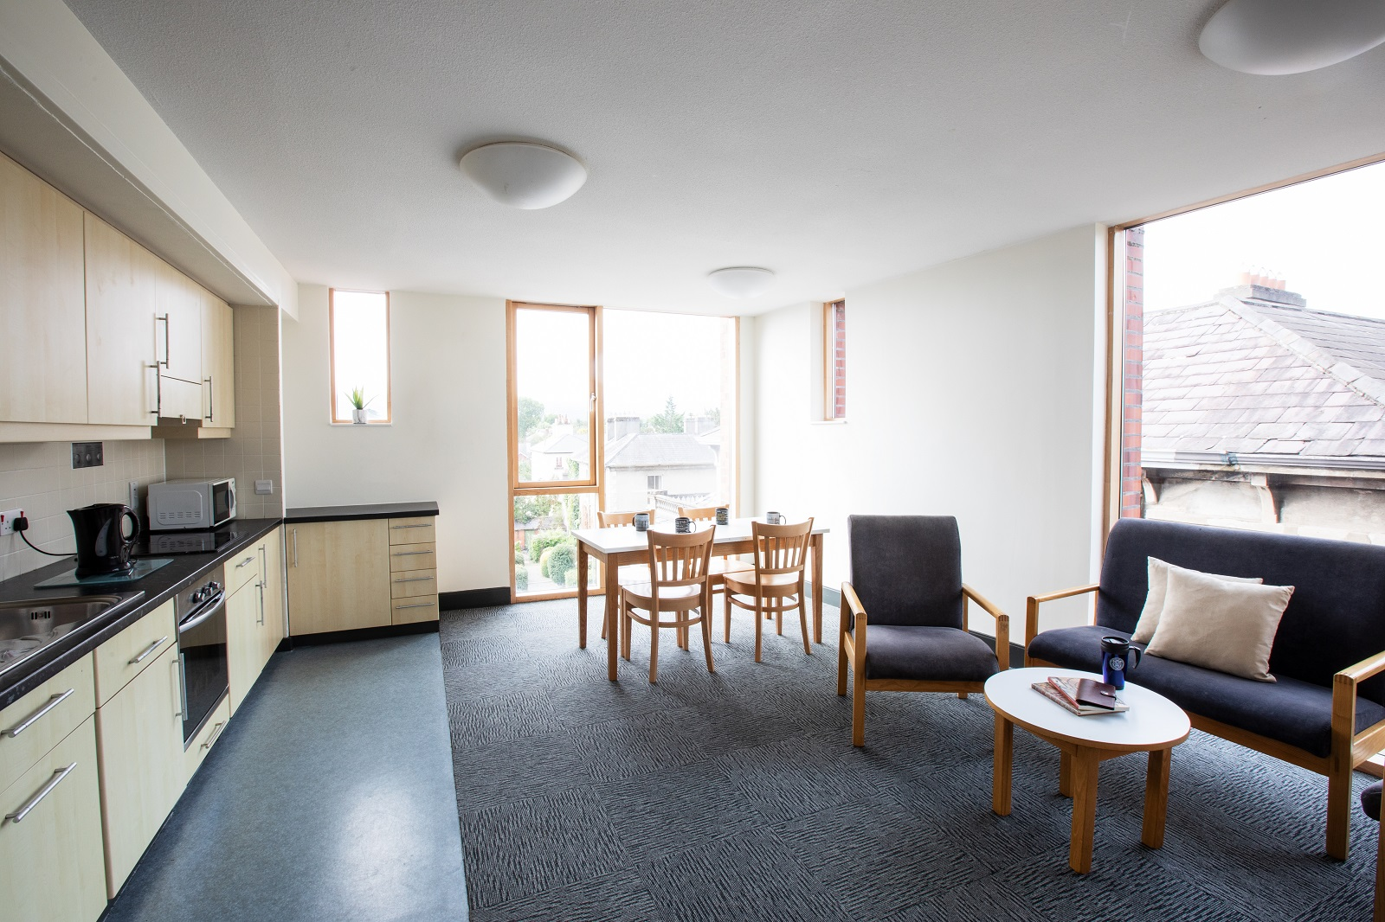
Managing Conflict in Shared Housing
Eimear Rouine
Transition to Trinity Officer

Slide 2
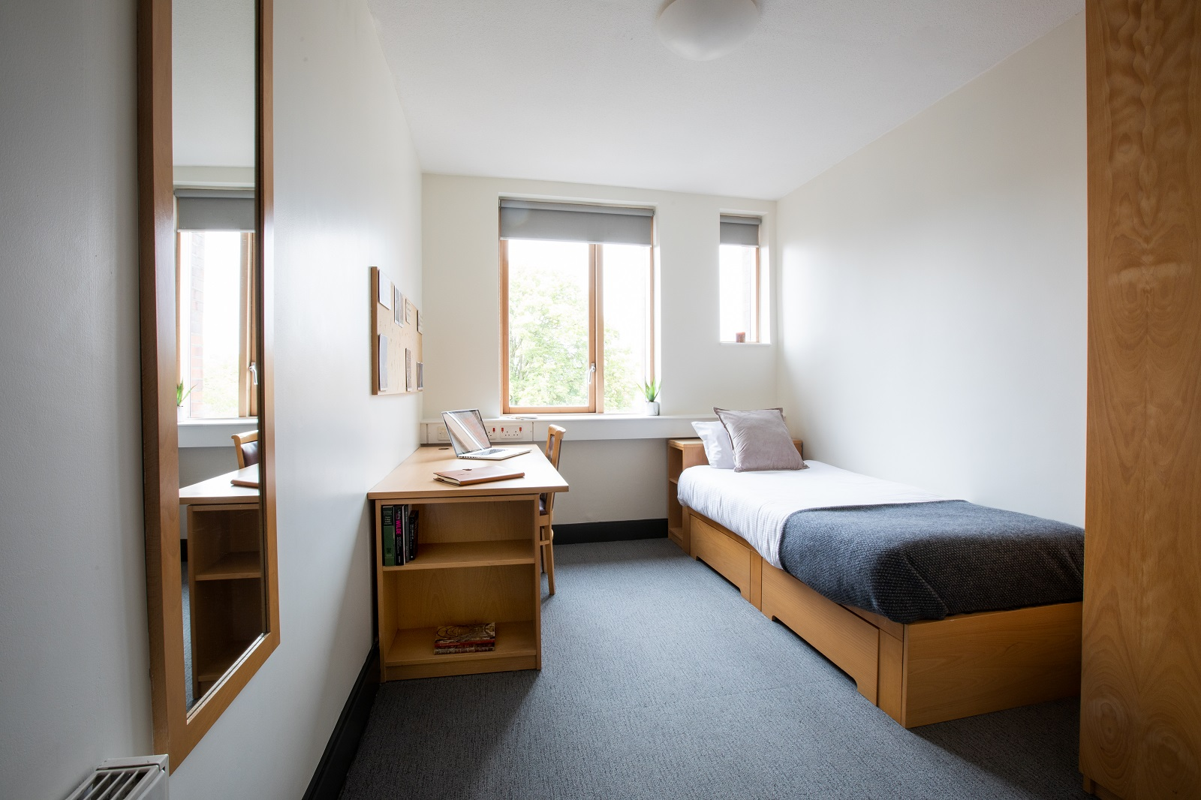
Living With People – The Basics!
Clean up after yourself
Don’t eat other people’s food without asking
Keep the noise down - particularly at night
Chip in for the essentials (toilet paper, cleaning products)
Stay out of each other’s rooms

Slide 3
Living With People – The Basics!
Keep each other in the loop if you’re having people over
Make sure you have your key
Share the horrible jobs (putting the bins out, cleaning the fridge)
Create some house traditions & get to know each other a bit
Look out for each other

Slide 4

7 Ways to Keep Your Relationship Healthy
Communicate your needs to your roommates
Establish your boundaries and respect theirs
Ask for permission, not forgiveness
Be mindful of the space you take up
Don’t force a relationship
Don’t say yes when you mean no
Empathise with your roommate

Slide 5
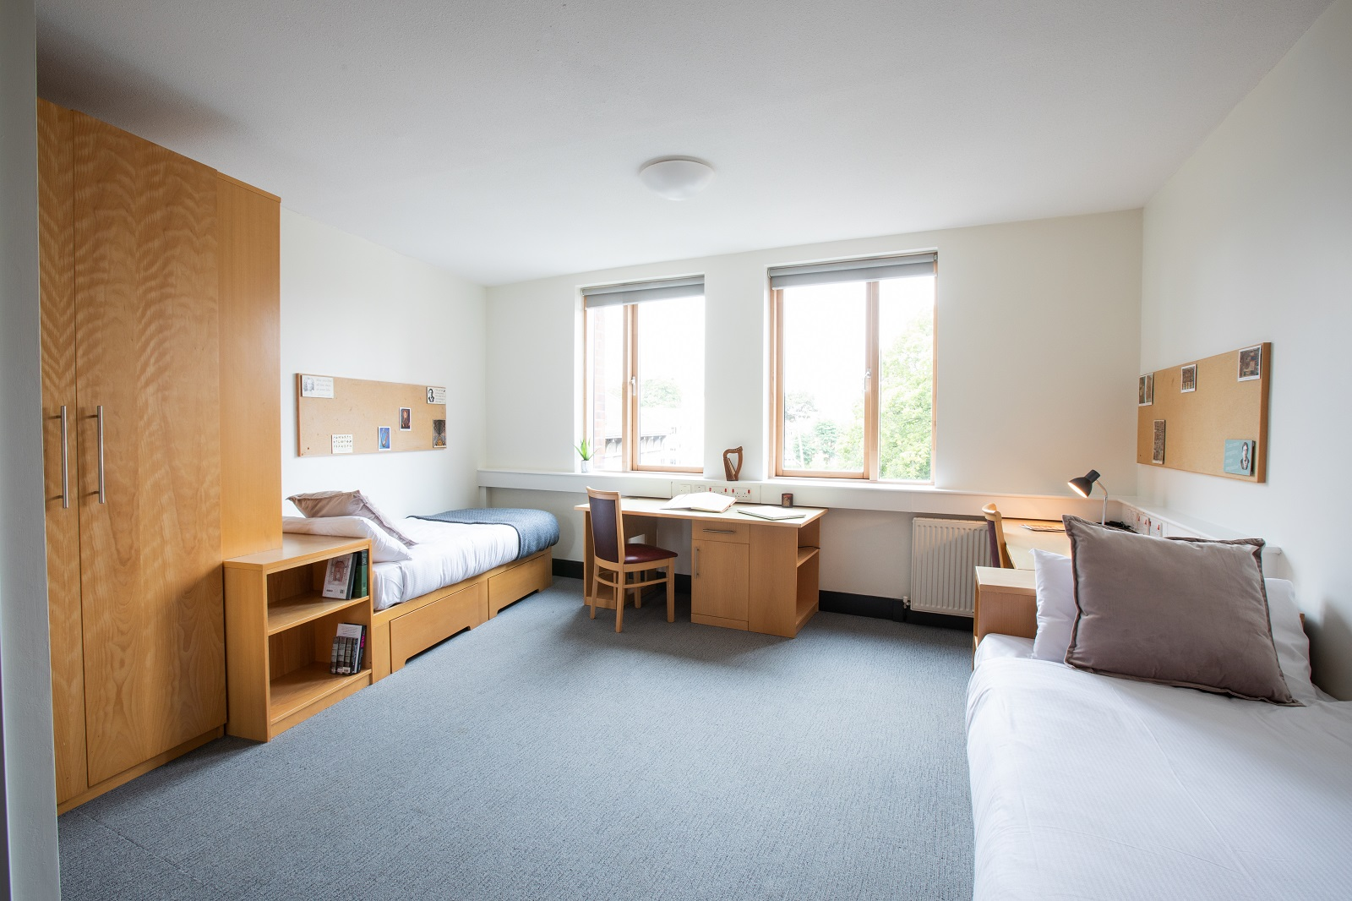
Setting House Rules and Boundaries
Have an initial house meeting to figure out what is really important to each of you in the common spaces
How will you organise cleaning of common spaces?
  A rota is one of the easier ways to divide up tasks fairly
Will you eat together or cook for yourselves?
Are milk, bread, butter for everyone or do you buy your own?
What about cleaning products and toilet paper?
  If you’re sharing these items, will you have a kitty or take turns?
How much notice would you like for guests or parties?
How much time do you expect to spend together?

Slide 6
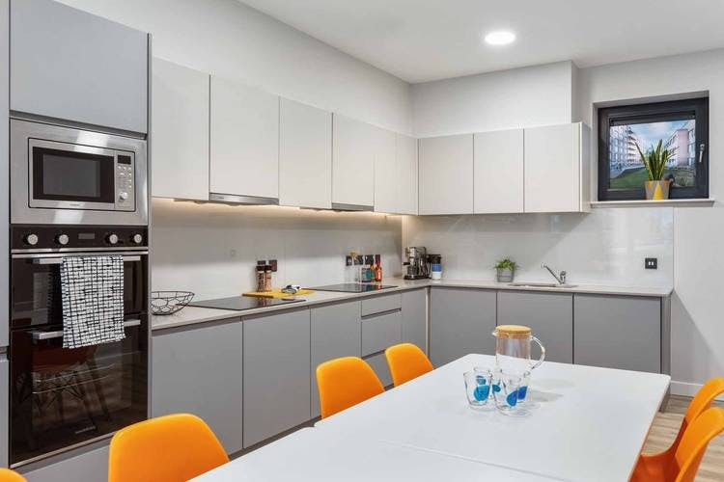
Your House Contract
Now that you have discussed your boundaries and the house rules, write them down! Be realistic so all roommates can manage their expectations.
Create a cleaning rota, and note what the house expects by ‘clean’
How long can you leave dishes after using them before washing up?
Write down how much money you expect each housemate to contribute to a kitty for shared purchases and how you have decided to share the responsibility for purchasing items
Write down your ‘quiet hours’
What is the policy on sharing food?
What is the policy on sharing belongings?
This may seem very formal, but it means that when conflict inevitably arises, you have an agreement you all signed to base your discussion on.

Slide 7

Common Flatmate Problems
Cleanliness
Food sharing/taking
Noise levels
Sleeping patterns and study habits
Lifestyle differences (smoking, alcohol, drugs)
Use of shared space
3rd wheel syndrome
Money

Slide 8
How to Approach a Problem With Your Flatmates
Pick your battles
Make sure that you are calm
Be prepared to listen as well as talk
Use ‘I’ statements – ‘I feel’, ‘I think’
Avoid accusing others – ‘I feel that the bins are not being taken out as often as we agreed, and I think we should talk about a different way of organising this’ is better than ‘You never take out the bin when it’s your turn’
Have your house contract and be ready to renegotiate it

Slide 9
What NOT To Do!
Don’t leave passive aggressive notes or send passive aggressive texts
Don’t ignore the problem and hope it goes away
Don’t have a ‘me vs them’ attitude
Don’t approach a conflict as a competition
Don’t ignore your own needs

Slide 10

Conflict Resolution Styles
Remember that everyone has different styles of conflict resolution:
Collaborating
Compromising
Avoidance
Accommodating
Competing

Slide 11

Money Matters
If you are staying in private accommodation, make sure to organise rent & bills
Who will look after collecting the rent?
Who will look after paying the bills, or will you each be responsible for one bill each?
What are the payment dates?
Cash or transfer?
Write all of this into your house contract

Slide 12
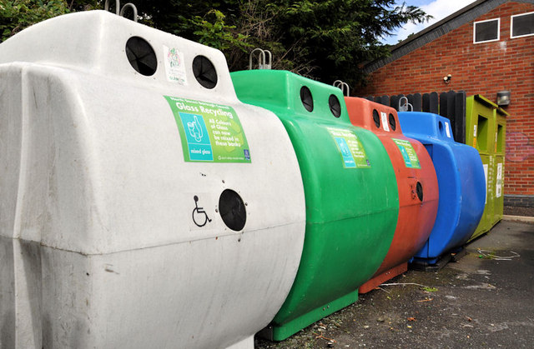
Keeping a Sustainable House
Turn off lights when not in use
Open the blinds!
Use fluorescent bulbs (you’ll save some money too!)
Turn off your laptop/iPads
At least put them to sleep after 10 minutes
Unplug appliances when not in use
Plug them into power strips and turn off at the wall
Unplug kitchen appliances too
Unplug
Lights
Switch Off

Slide 13

Two Golden Rules for Flatmates:
RESPECT & COMMUNICATION

